Slide 1
Processing Data, Part 2
Section 2
Chapter 5
© 2016 Pearson Education, Ltd. All rights reserved.

Slide 2
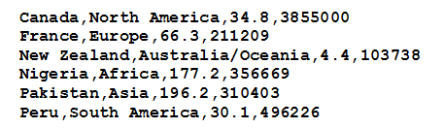
CSV Files
Text files considered so far had a single piece of data per line
Consider CSV formatted file
  Several items of data on each line
  Items separated by commas.
© 2016 Pearson Education, Ltd. All rights reserved.

Slide 3
CSV Files
Each line of this text file is called a record
Each record is said to contain four fields—a name field, a continent field, a population field, and an area field.
The data in the fields of each record are related—they apply to the same country.
© 2016 Pearson Education, Ltd. All rights reserved.

Slide 4
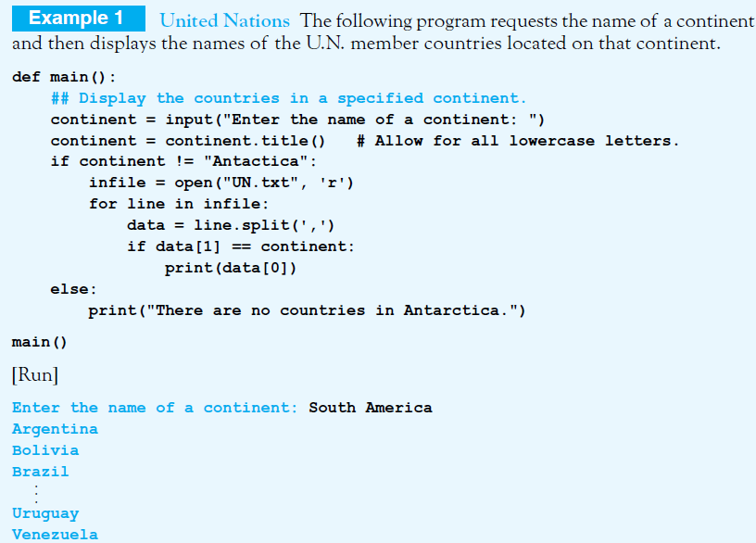
Accessing the Data in a CSV File
The split method is used to access the fields
© 2016 Pearson Education, Ltd. All rights reserved.

Slide 5
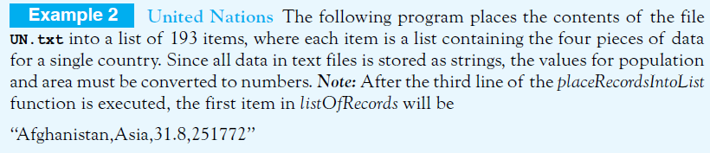
Analyzing the Data in a CSV File with a List
Data can be analyzed by placing data into a list
  Items of the list are other lists
  Holding the contents of a single line of the file
© 2016 Pearson Education, Ltd. All rights reserved.

Slide 6
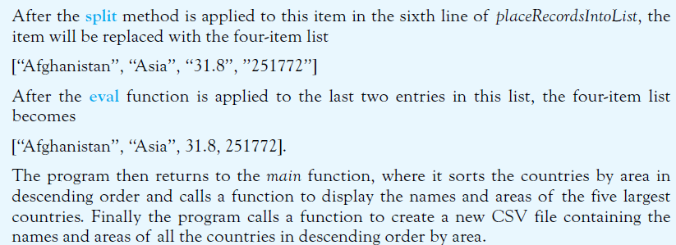
Analyzing the Data in a CSV File with a List
© 2016 Pearson Education, Ltd. All rights reserved.

Slide 7
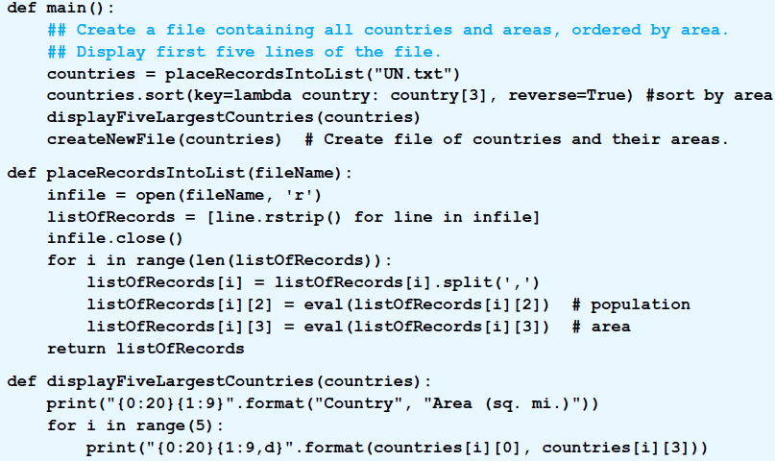
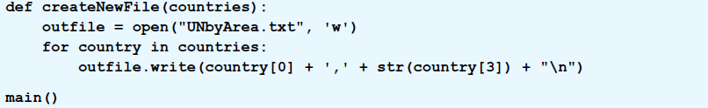
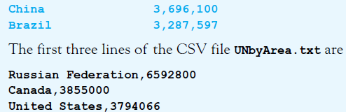
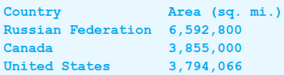

Slide 8
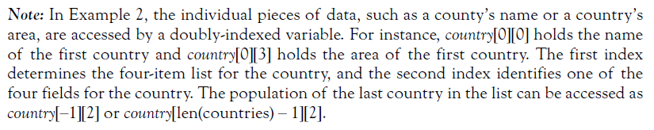
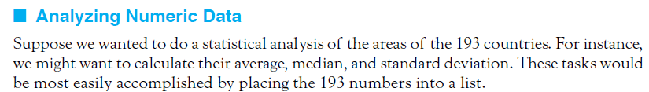
Analyzing the Data in a CSV File with a List
© 2016 Pearson Education, Ltd. All rights reserved.

Slide 9


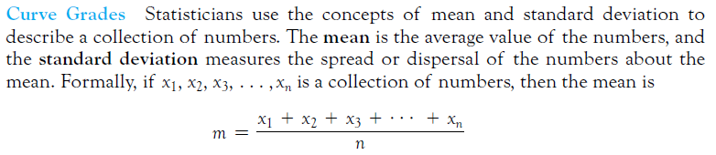

Analyzing Numeric Data
© 2016 Pearson Education, Ltd. All rights reserved.

Slide 10
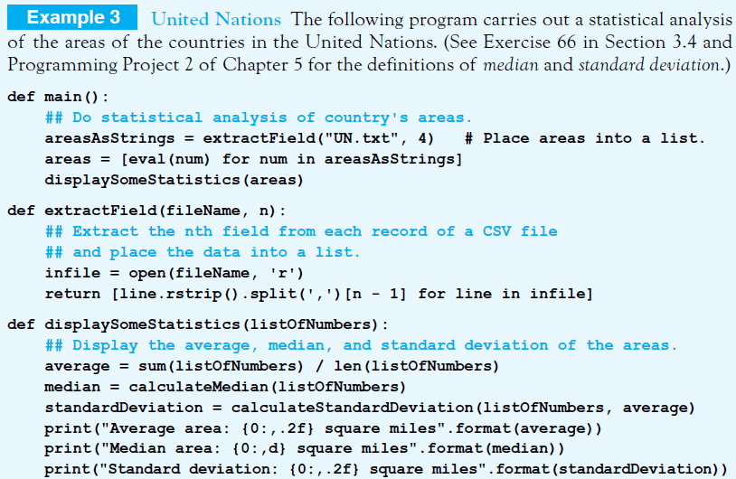
© 2016 Pearson Education, Ltd. All rights reserved.

Slide 11

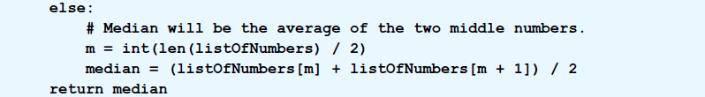
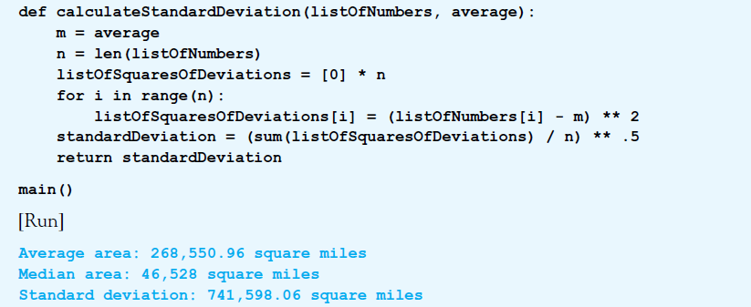
© 2016 Pearson Education, Ltd. All rights reserved.

Slide 12
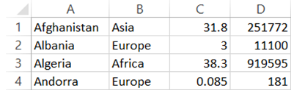
Excel and CSV Files
CSV files can be converted to Excel spreadsheets and vice versa
  Open UN.txt file in Excel, select comma when asked for delimiter
FIGURE 5.12 Spreadsheet Created from UN.txt.
© 2016 Pearson Education, Ltd. All rights reserved.

Slide 13
End
Section 2
Chapter 5
© 2016 Pearson Education, Ltd. All rights reserved.

